Slide 1
Hybris Introduction &
Development Environment Setup

Slide 2
Agenda
HYBRIS CONCEPT
HYBRIS PRODUCT AREA
HYBRIS PLATFORM
HYBRIS PCM
HYBRIS B2C COMMERCE
HYBRIS CHANNEL
HYBRIS BASIC ARCHITECTURE
HYBRIS MULTICHANNEL SUITE INSTALLATION
MODES OF OPERATION OF HYBRIS
ANT BUILD TARGET
INSTALLING THE HYBRIS COMMERCE SUITE
HAC
INTIALIZATION AND UPDATE
ECLIPSE INTEGRATION

Slide 3
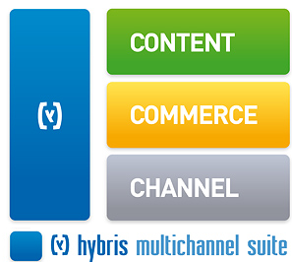
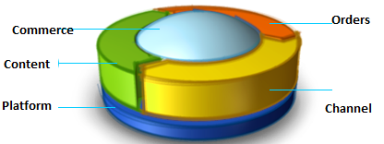
Hybris Concept
Hybris delivers enterprise software and on-demand solutions for multi-channel commerce, master data management and order management that helps retailers, manufacturers, distributors, Telco's and publishers of software, games and digital media to innovate, sell more and create perpetual digital relationships with their customers.

Slide 4
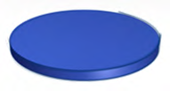

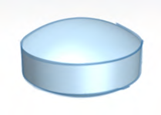








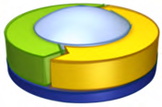
Hybris Product Area
Platform
Channel
PCM
Commerce
Multichannel Suite

Slide 5

Hybris Platform
Hybris Platform consists of core functionality and other additional functionality built on it.
It mainly consists of:
Set of standard set of extensions, providing main functionality.
Extension:
Represents the technical structure of a module
Can contain business logic, type definitions, a web application, or other
Database and application server abstraction
Layer Configuration files.
Third party libraries.
Build framework.
Hybris Server.

Slide 6


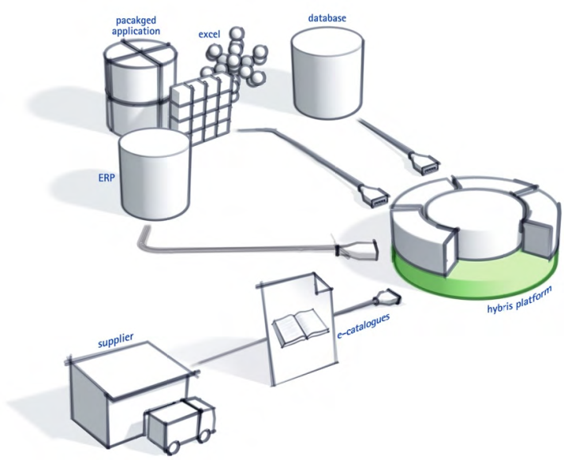
Hybris PCM
Hybris PCM (Product Content Management)is a robust Product Information Management [PIM] product.
One source for all product data
Intuitive, powerful browser-based user interface
Synchronization with external systems
Data exchange via standardized interfaces
Product data publication into different catalogs
Easy to define workflows
(Multi-) Classification
Import & export of all kinds of data
Media Asset Management
Hybris Media Management
Integration of Celum Imagine

Slide 7
Hybris PCM
Product Content Management :
One source for all product data
Intuitive, powerful browser-based user interface
Synchronization with external systems
Data exchange via standardized interfaces
Product data publication into different catalogs
Easy to define workflows
(Multi-) Classification
Import & export of all kinds of data
Media Asset Management
Hybris Media Management
Integration of Celum Imagine

Slide 8
Hybris PCM
Product management performs an inter-disciplinary role in the e-commerce market. To develop and grow a company, you need to look at product selling from a multiple perspective approach. It is not only about data sources but also about how to be offline and online in the full sense of the omni-commerce word.
In Hybris system, you can administer product information and attributes across channels which allow you to map all functionality together. The user-friendly GUI gives you an opportunity to easily catalog your products, maintain digital objects, language, or stockroom locations.
Hybris Product Content and Catalog Module, ensures you consistency, reliability, flexibility, and simplicity in information enablement and Structuring the content for products.

Slide 9
Hybris Commerce
Hybris e-Commerce solutions to support every step of the e-Commerce process, from marketing and merchandising, to sales transactions and service. The Hybris Commerce Suite enables organizations to manage multiple sales and communications channels on a single platform.
It provides everything you need to deliver the ultimate multichannel experience that is both global and highly personalized to customers, prospects, suppliers, and partners — ensuring that they are always able to engage with you, and vice versa, wherever they sit and via whatever medium they choose. Most importantly, the hybris Commerce Suite guarantees a consistent customer experience, giving you the confidence that every customer and partner transaction is positive and profitable.

Slide 10

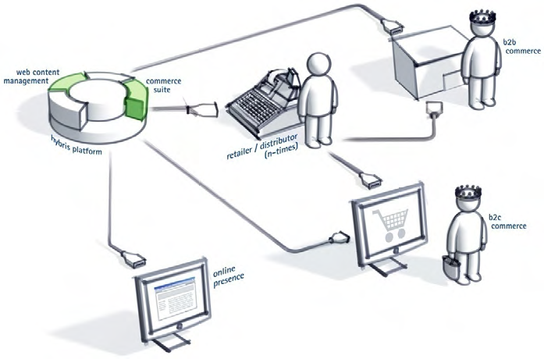

Hybris B2C Commerce
Hybris B2C Commerce enables enterprises to manage their customers’ data, including related cross-channel sales. It also helps to segment customers and provide them with targeted email marketing or other campaigns. Based on these segments, hybris enables retailers to address target groups with specific products, prices or campaigns.

Slide 11
Hybris B2B Commerce
Hybris B2C Commerce delivers functions such as detailed metadata management, URL rewriting and search engine optimized frontend creation to promote top ranking in organic search results. It supports the creation of dynamic landing pages to drive traffic with targeted ads or Google campaigns. Furthermore, hybris enables customers to attract additional customers with affiliate marketing, through targeted email campaigns or by meeting customers in social networks such as YouTube, Facebook or Twitter.
Hybris B2B Commerce reduces complexity by consolidating management of multiple business models, channels and markets. It enables B2B organizations to accommodate a wide variety of suppliers, distributors and stores on a single platform.
The hybris B2B Commerce enables customers to manage their accounts and place orders in the self-service area of the B2B online store. They can assign rights to their employees, set up individual purchasing limits, approval rules and workflows, and maintain cost centers and budgets. Moreover, B2B customers share retail-like shopping experience, thanks to applied buyer-centric B2B merchandising.

Slide 12




Hybris Channel
Barcode integration
Mobile web shop template
Store Locator
WCMS integration
Call center application
Full-scale pre- and post-order process at your fingertips
User interface optimized to run on low-end machines
Supports all means of automating publications
Last minute publication updates
User interfaces and workflows for all phases of publication
Supports Multi-Store scenarios
User interface for controlling static and dynamic web site content
Independent from any frontend technology

Slide 13
Hybris Online Channels
Hybris Customer Service Module provides the Customer Service Agents (CSAs) with easier and faster access to the information needed to understand and quickly resolve customers’ problems. CSAs can use the Customer Service Module to create new orders, modify previously placed orders, complete partial orders, take payments, cancel orders, authorize returns and refund payments.
Hybris Mobile Module is an out-of-the-box mobile solution that supports all m-Commerce processes from rich product presentation over search and navigation to mobile payment and fulfillment. It is fully integrated into the hybris e-Commerce solution so retailers can easily integrate mobile as part of a holistic multichannel strategy. The hybris Mobile Module also supports barcode and NFC integration.

Slide 14
Hybris Online Channels
Hybris Web Content Management System Module is a marketing and publishing tool that offers Web content management capabilities that are fully integrated with product content management (PCM) and multi-channel commerce functions.
hybris Web Content Management System Module, makes it easy to manage content across channels – including online, mobile, and Rich Internet Applications – from a single user interface. The solution supports such features as comprehensive preview capabilities and the ability to make changes via live edit which enable organizations to easily place and re-use cross-channel marketing campaigns.
The hybris InStore Module is the purpose-built application running on the tablet device. It enables the retailer to identify products, display the detailed product information, and check stock levels.

Slide 15
Hybris Offline Channels
Despite predictions of a paperless world, printed catalogs and flyers continue to be important for retailers, manufacturers and distributors. To be effective, print materials must be kept up-to-date and consistent with content being used on other marketing channels. To be cost-effective, catalog publishing must also be automated so it delivers relevant and accurate content without requiring manual content development.
The hybris Print Module provides the best of both worlds, delivering advanced content management and automation that enables easy creation of printed materials while increasing efficiency and reducing costs.

Slide 16
Hybris Server
The hybris Commerce Suite comes pre-bundled with a Apache Tomcat web container plus configuration settings. The Apache Tomcat can be used out-of-the-box for development and production use. This concept of a pre-bundled Apache Tomcat and configuration settings is called the hybris Server. To deploy new versions of the hybris software, you can simply replace the entire hybris Server with a newer version.
Features of Hybris Server
Optimized and pre-configured server based on Apache
Tomcat
Production-ready quality and best suited to run all applications of the hybris Multichannel Suite
Configuration templates available for development and production deployment
Independent of the operating system
Easy installation
Can be run as a system service under Microsoft Windows or Linux.
Contains a wrapper that automatically restarts the Apache
Tomcat Java Virtual Machine if the Apache Tomcat hangs or stops.

Slide 17
Advantages of Hybris Server
Advantages: compared to other application servers with EAR deployment
Identical setup and usage for development, staging, and live system
Dramatically simplified installation, deployment, and configuration
Very small footprint – faster than WebLogic or WebSphere on the same hardware
Complete support for virtualized environments (“Ready for the cloud”)
Free of charge, part of the hybris Multichannel Suite
(free security updates, for example)
Reduce hosting partners’ costs
hybris Server Support is included in the standard hybris Service Level Agreements
Reduces customers’ cost for support and training

Slide 18
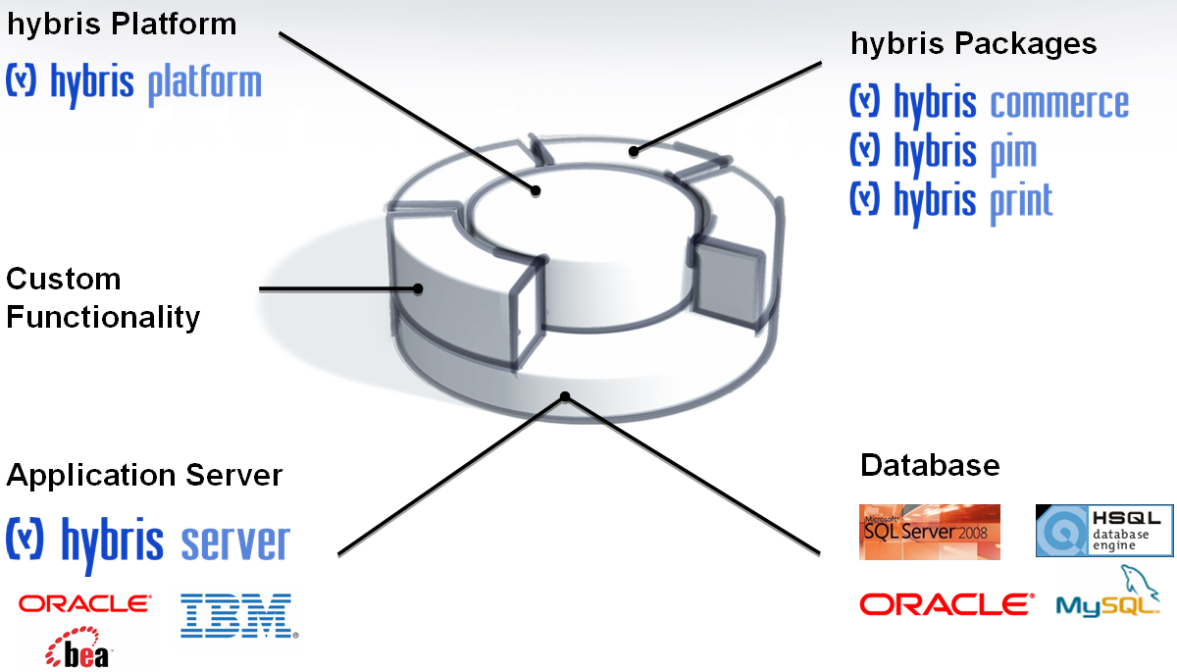
HYBRIS BASIC ARCHITECTURE

Slide 19
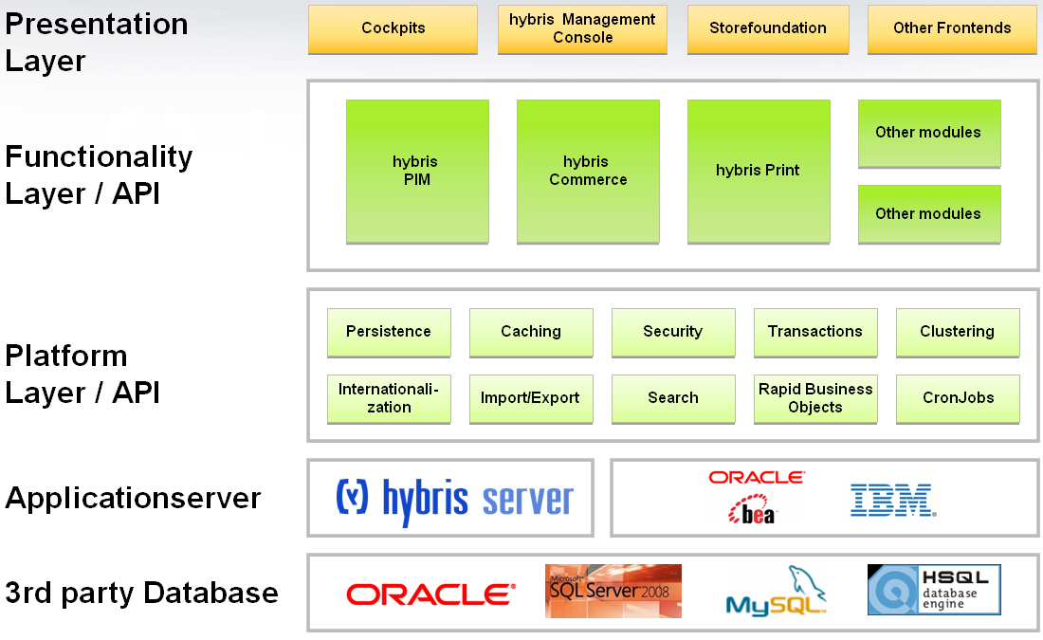
Hybris Multichannel Suite installation

Slide 20
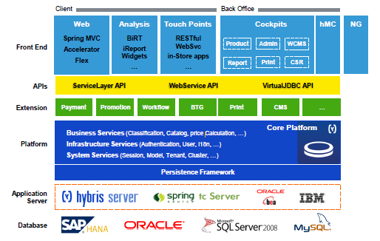
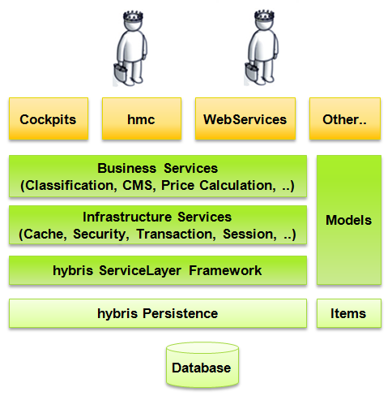
Overview of the Architectural layers

Slide 21
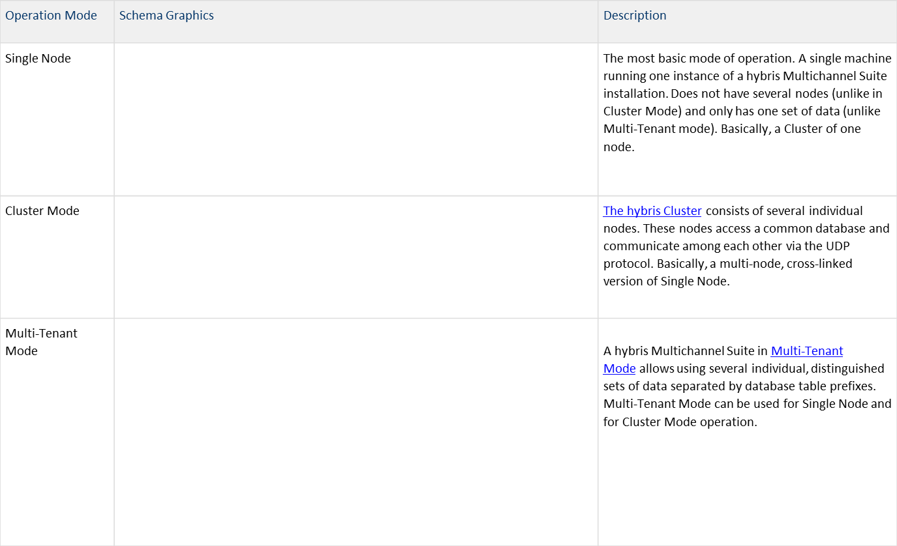
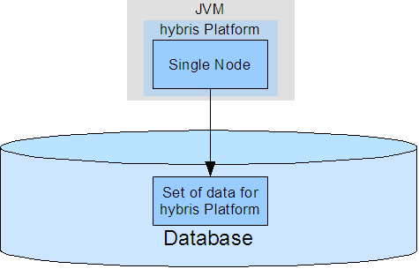
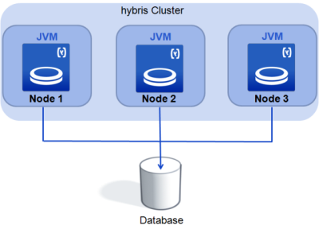
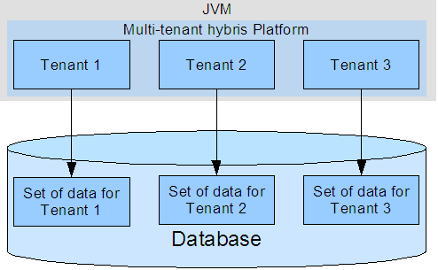
Modes of Operation of Hybris

Slide 22
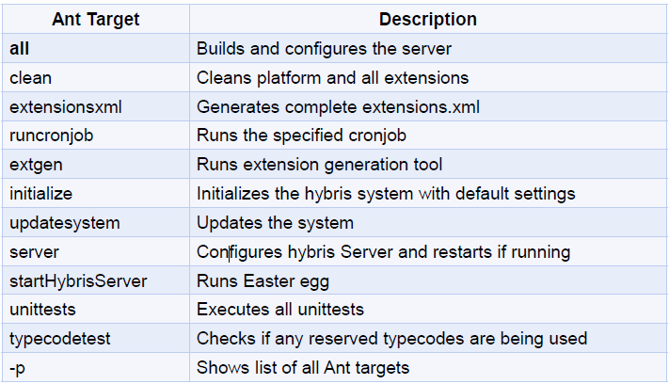
Ant Build Targets

Slide 23

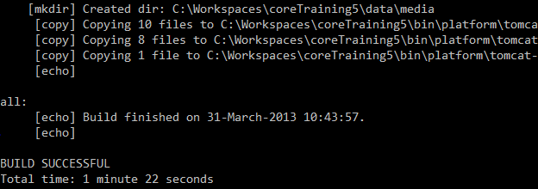
Installing the Hybris Commerce Suite
Install the most recent version of the Java Development Kit( JDK 7)
Enter “java –version” to test your Java installation
Install hybris platform from-
https://download.hybris.com/resources/releases/5.3.0/hybris-commerce-suite-5.3.0.2.zip
Open a console window and go to hybris/bin/platform
Call setantenv.bat
Call ant to build
Select a default develop configuration template (develop and production are available).

Slide 24
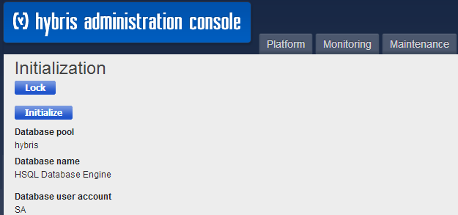
Installing the Hybris Commerce Suite
Call hybrisserver.bat (OSX/.Linux: hybrisserver.sh) to start hybris platform.
Open localhost:9001 in your browser and hit “initialize”.
Have fun:
localhost:9001/
localhost:9001/hmc

Slide 25
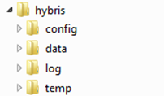
Installing the Hybris Commerce Suite
When you call ant, the build framework:
generates and compiles “Model” classes
according to the definitions in the *-items.xml files
In order of extensions dependency (hierarchy)
collects localization property files (locales_XY.properties).
collects layout configuration files (hmc.xml).
updates configuration of the hybris Server
generates following folders (only in first run!)

Slide 26
Installing the Hybris Commerce Suite
Each extension has:
project.properties with extension-specific configuration
extensioninfo.xml with extension dependencies configuration
For global settings and to override any extension specific configuration always use the config folder, it contains:
local.properties
Overrides any properties specified in each extension project.properties file
Introduces global properties like database url and credentials
localextensions.xml
List of extensions used by build framework
Beside that: configuration templates for bundled servers, language packs, license.
Please install hybris commerce suite by following the document-

Slide 27
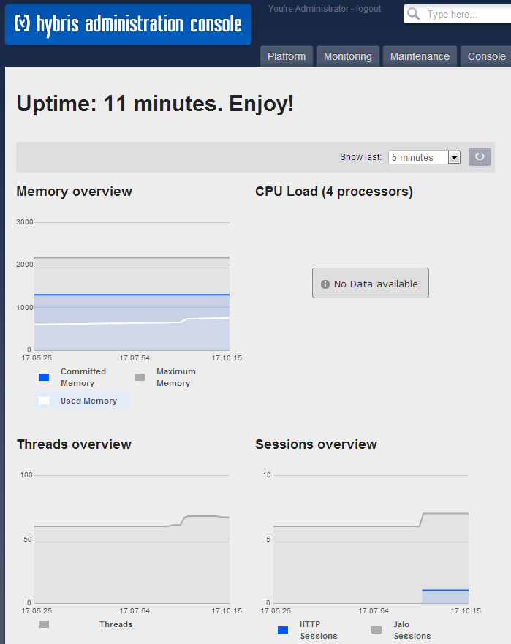
hac – hybris Administration Console
Administration
Monitoring
Configuration
localhost:9001/ (by default)

Slide 28
Initialization and Update
System Initialization:
Entire type system is created from scratch.
ALL database tables are dropped.
Data model is created from scratch as defined in the items.xml files.
New tables with initial dataset are created
Existing data model definitions will be lost!
System Update:
Existing tables are updated to match changes in the domain model.
No loss of data!
Two major aspects:
Adding newly defined types to the type system definition in the database
Modifying type system definition in the database to match the definition in the domain model

Slide 29
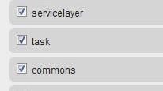
Essential Data vs. Project Data
Essential Data
Necessary during initialization:
Creates the Default catalog, restrictions, and basic CronJobs, for example.
Project Data:
Extension-specific project data
How to include:
Convention over Configuration essentialdata*.impex, projectdata*.impex
Hook Service Layer code into hybris initialization and update life-cycle events @SystemSetup annotation

Slide 30
Extension Concept
Developing a new project with its own data model and
business logic starts with the generation of a new extension.
That way your (project) code is separated from hybris (framework) code, making your code easier to reuse and to migrate to future versions.
hybris bundles a proprietary code generator.
Examples:
Frontend extnesion: with all jsp pages, css, controllers
Testing extension: has all the test cases and data (such as testdata)
Infrastructure or utility extension (such as services)
Extension Basics
Extensions are encapsulated modules, which can contain - business logic ,data model definition , web application.
By default: independent from other extensions (except platform)
Extension concept benefit: Easy to migrate and update
Always use your own extn to create, extend or to overload existing hybris code !!!

Slide 31

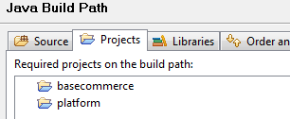
Extension Dependency Management
Extensions depend on each other,
All extensions implicitly depend on the hybris Platform
Each extension is an individual Eclipse Project
Dependency Management is done the extensioninfo.xml file:
Eclipse projects dependency configuration must be done separately
Cyclic dependencies are prevented by build framework

Slide 32
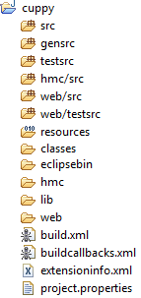
Structure of an Extension
Compiled sources
Generated Java files
hMC module
External library files
Type definitions & localization
Resources folder for external data
Business logic
JUnit test classes
Web module
Files for Eclipse, Apache Ant, and
extension-specific configuration

Slide 33
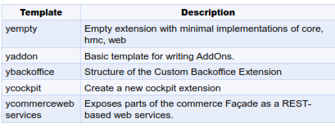
How to Create a New Extension
Invoke ant extgen <ENTER>
Select an extension template, such as:
yempty: A bare skeleton
ycockpit: Creates a new cockpit extension
Extension should be referenced in the localextensions.xml file
<path dir="${HYBRIS_BIN_DIR}"/>
<extension name="myextension"/>
Call ant clean all <ENTER>
Select template when creating a new extension
Overview of all templates
wiki.hybris.com/display/release5/Creating+a+New+Extension#CatingaNewExtension-availabletemplates

Slide 34
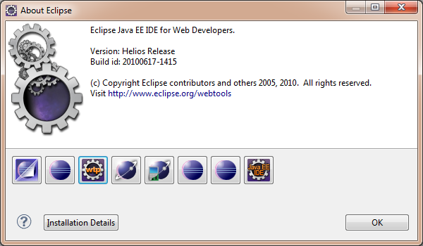
Eclipse Integration
You can use an out-of-the-box Eclipse installation.
Be sure to use the latest Eclipse version with Web Tools
Platform is installed:
www.eclipse.org/downloads
Or Spring Tool Suite

Slide 35
Importing the hybris Suite as an Eclipse Project
Open the File menu and click on Import.
In the Select screen of the Import wizard:
Expand the General section.
Select Existing Projects into Workspace.
Click on the Next button to continue.
In the Import Projects screen of the Import wizard:
Click on the Browse button for the Select root
directory field.

Slide 36
Importing the hybris Suite as an Eclipse Project
Navigate to the hybris directory of your installation.
Select the hybris directory and click on the OK button.
Back on the Import Projects screen of the Import wizard:
Check or clear the projects Eclipse has located.
Make sure that Copy projects into workspace is NOT ticked.
Click on the Finish button.
Eclipse will now refresh the workspace.

Slide 37
Debugging with Eclipse IDE
Debugging with Eclipse IDE
You can change the debug settings in the local.properties file.
In Eclipse, go to Run -> Debug configurations …
Create a new Remote Java Application, Enter a name (such as training).
Connection type: Standard
Host:Port – localhost:8000 (default; configurable in local.properties)
Click on the Debug button.
Switch to the Debug perspective.
Open the file to be debugged (.java, .jsp).
Navigate to the line where you want to add a breakpoint.
Double-click on the gray border on the left hand side of the line numbers.
A breakpoint icon should appear.
If that icon has a small check if it is synchronized with the hybris
Server.
Eclipse will now stop at this line.

Slide 38
Thank You

